Slide 1
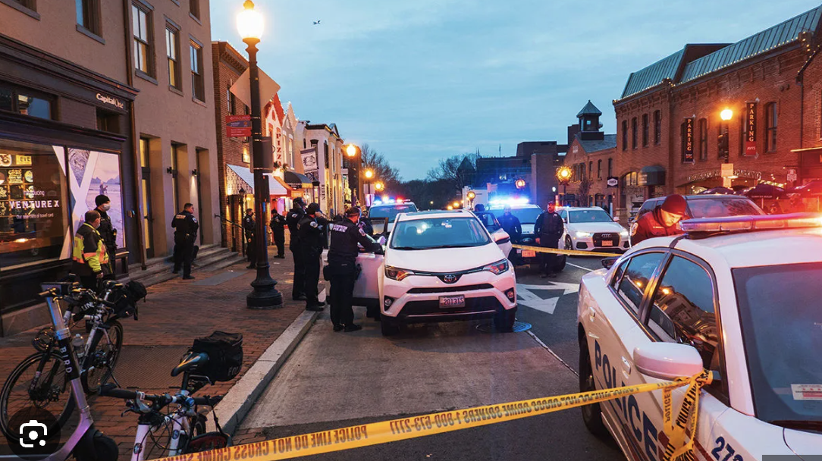
Crimes and Their Patterns: Visual Inspection
Helen Zewdu
Spring Introduction to Data Science
MATH-014-01
Spring 2026 - Howard University

Slide 2

Data Set Overview
Dataset chosen: Washington, D.C Crime Incidents (2025)
Variables and Records: Offense Type, Hour of Crime, Shift (morning, afternoon, evening), Latitude and Longitude (geographic location).
Importance/Significance: This data set shows real-word crime patterns and occurrences happening within the Washington, D.C area in the year of 2025. In addition, this helps us examine both the time and geographic significance that plays a part in crime occurrence.

Slide 3

Objective: Crime Analysis
Research Question: How does the frequency of crime fluctuate in various times of the day?
Analyze and examine crime occurrences within the Washington D.C Metropolitan area.
Look at the relationship between different variables so that I can see trends and patterns.
Uncover whether a specific time have more/less crime occurences.

Slide 4

Data Cleaning & Preparation
Cleaned and Prepared the data set by understanding how many rows and columns: 24151 rows and 25 columns.
Looked for missing values: Missing values in variables END_DATE, DISTRICT, PSA, BID, and OCTO_RECORD_ID. (removed these irrelevant columns.)
Found 0 duplicated records.
Standardized column names and string entities to ensure clear and consistent patterns for data analyzation.
Datetime objects: start_date --> 'hour'
Dropped irrelevant columns unnecessary towards my research.
Created variables "hour" and encoded offenses for numeric visualizations.

Slide 5

Key Analysis Questions
Main Research Question:
How does the frequency of crime fluctuate in various times of the day?
Additional Research:
Does crime frequency differ by neighborhood cluster?
Does latitude (geographic location) vary by the type of offense committed?

Slide 6
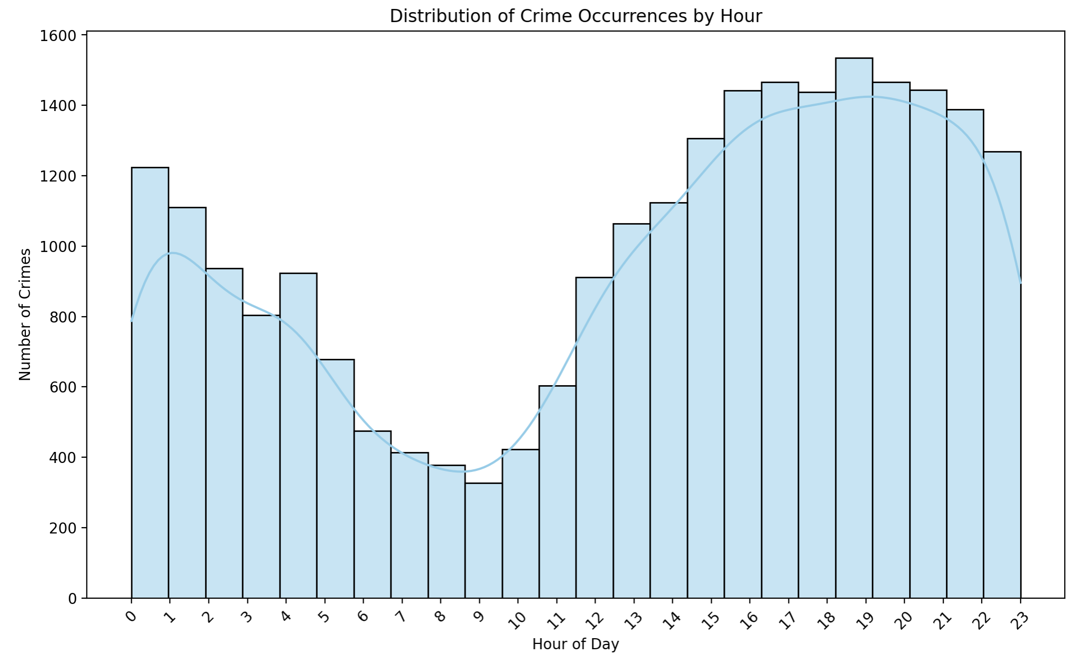
Histogram – Number of Crimes per Hour
What: Shows crime frequencies and its changes throughout the day.
Why: Helps name which hour of the day holds more crime occurrences so that I can further analyze my research question.
Insight: Peak of crimes occur in the evening's hours, supporting my research question.
Example: Difference between hours 15-21 (approx. 3-9 p.m.) higher frequency than hours 6-9.
Supports research question in that crime increases in the evening hours.

Slide 7
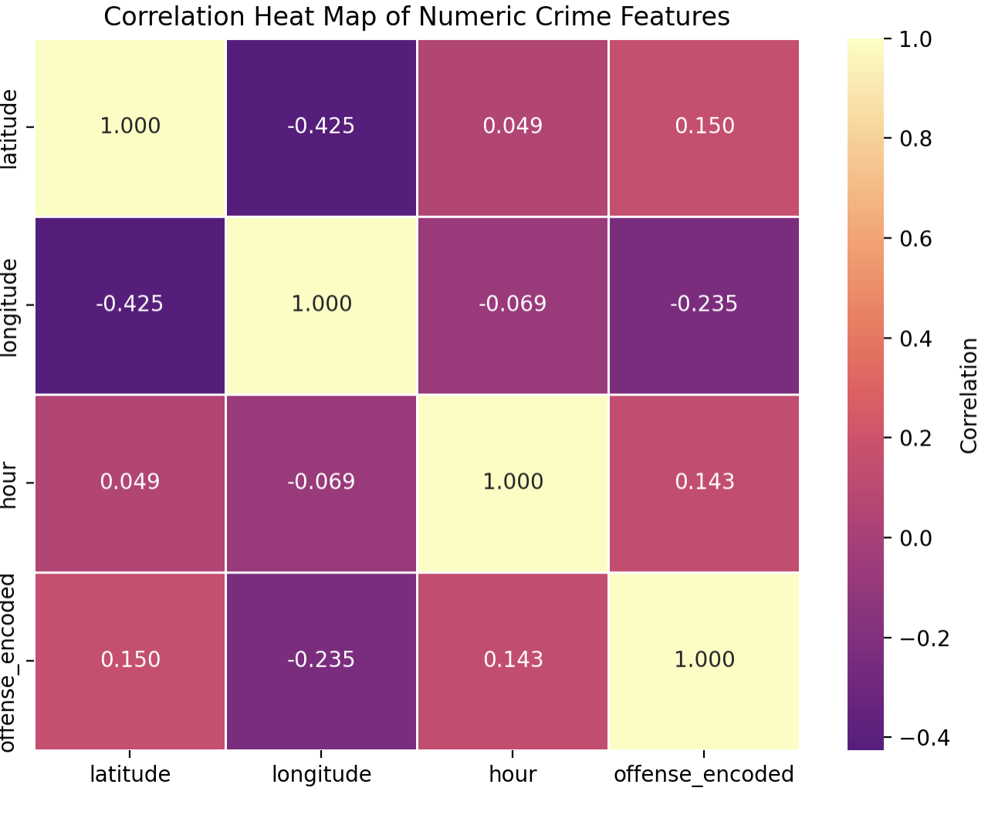
Heatmap – Is this a simple relationship?
What: Shows the strength and direction of numerical values such as hour, latitude, longitude.
Why: Do these variables have a relationship? Are they directly correlated to one another?
Insight: Weak relationships between variables. Crime occurences do not hold consistent rates of change.
Example: Variable strength and direction all closer to the value of 0 (hour and longitude, offense type and hour).
When the hour of the crime changes, other variables do not sequentially grow or decline.

Slide 8
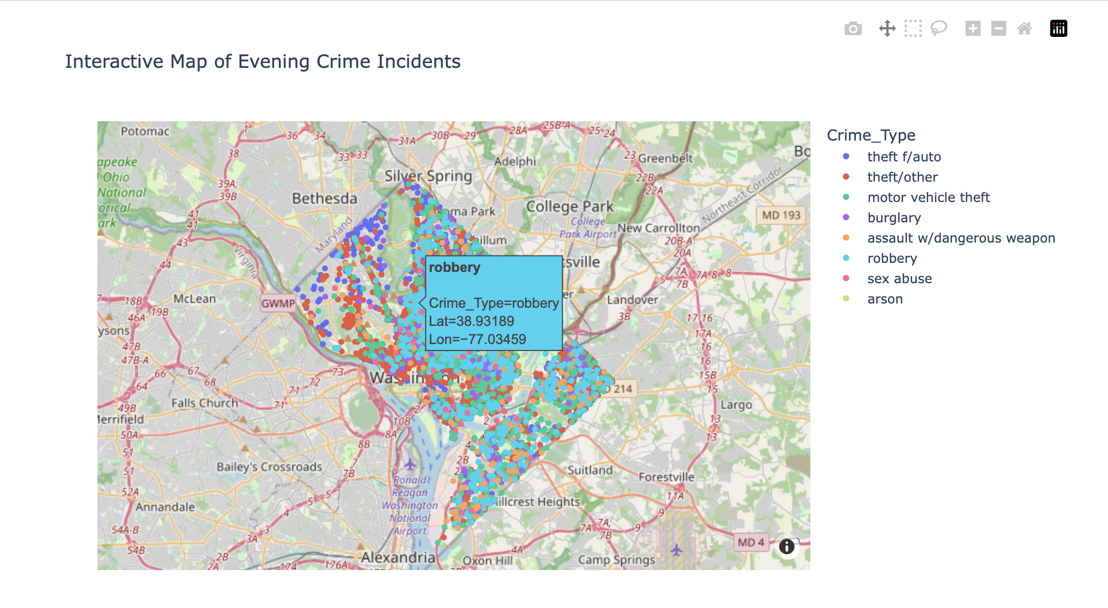
Geo-map: Evening Crime Incidents
What: Interactive map that displays the spatial patterns within the Washington D.C area.
Why: Helps analyze the different areas in which crimes may occur more often.
Insight: Crimes are clustered in the center of the map, near the center and of downtown D.C.
Example: clustered points of crime are in the center of Washington, D.C. In comparison, other areas on the map have less frequent crime occurrences.
Colored dots = specific crime (cluster of blue dots showing a high rate of armed robberies.

Slide 9
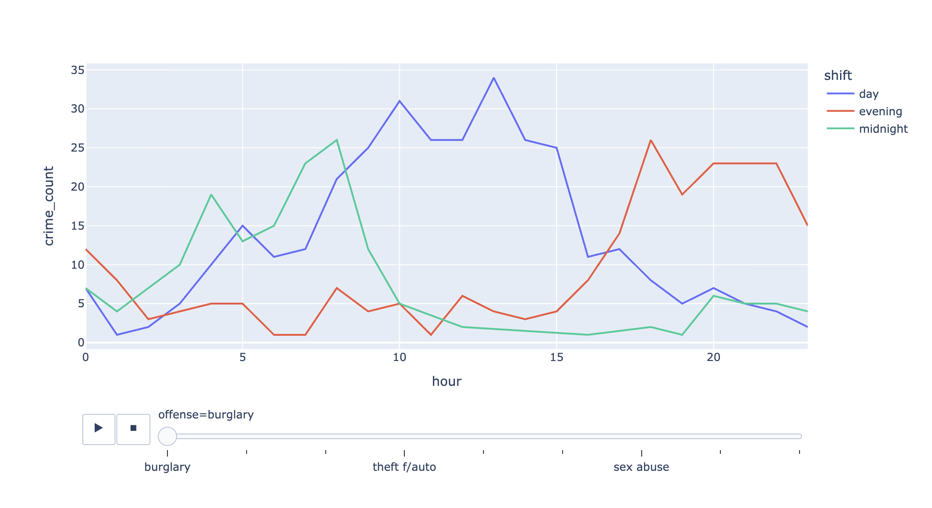
Animated Line Plot Chart
What: Animated line chart showing the temporal crime patterns between shift of the day and hour by crime type.
Why: Interactive graph that visualizes the change in crime through crime.
Insight: When animating the graph, the red line (evening) peaks higher during hours 15-20, showing higher crime frequency later in the evening.

Slide 10
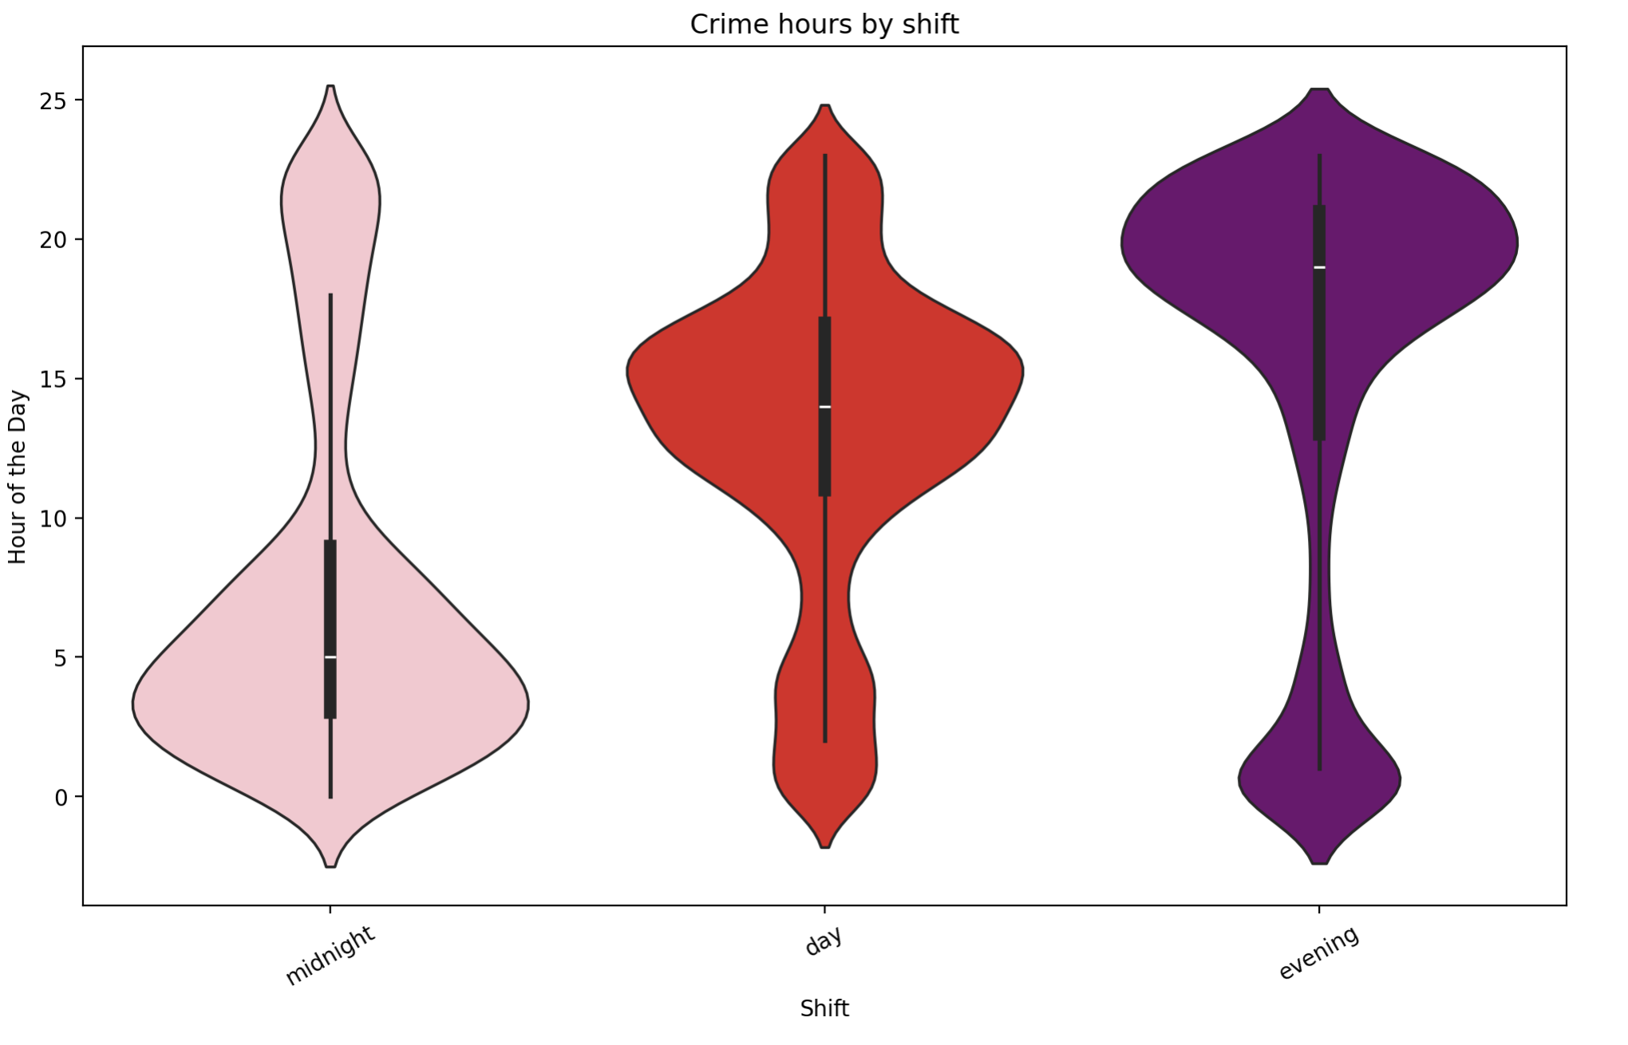
Violin Plot
What: A unique visualization that analyzes what specific hours within the shift (midnight, day, evening), a crime occurs.
Why: Goes in depth with the specific hours crime is dense.
Insight: When looking at the evening part of the graph, it is wider around hours 15-22, showing which part of the evening the most crimes occur.
Other violins are more evenly dispersed, while the evening and midnight plot spike at certain hours.

Slide 11
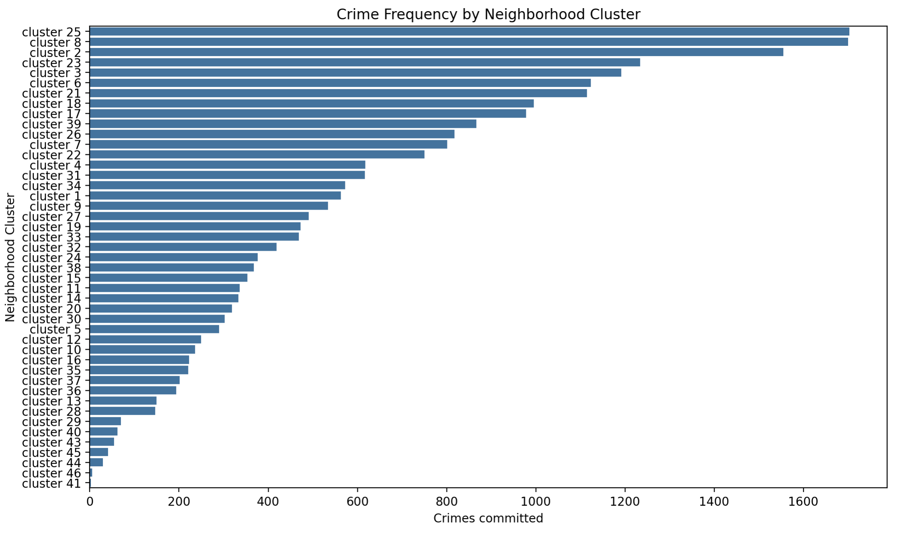
Additional Analysis: Count-plot Does crime frequency differ by neighborhood cluster?
What: Looks at the occurrence of crime regarding different neighborhoods.
Why: Analyzes the neighborhoods that experience higher crime rates.
Insight: Crime occurrences significantly differ in different neighborhoods.
Example: While some neighborhood cluster have a low frequency (cluster 41, 43, 40, etc.) some have a higher frequency of crime as seen by the longer bar (cluster 25, 8, 2).
Social, economic factors and their influence.

Slide 12
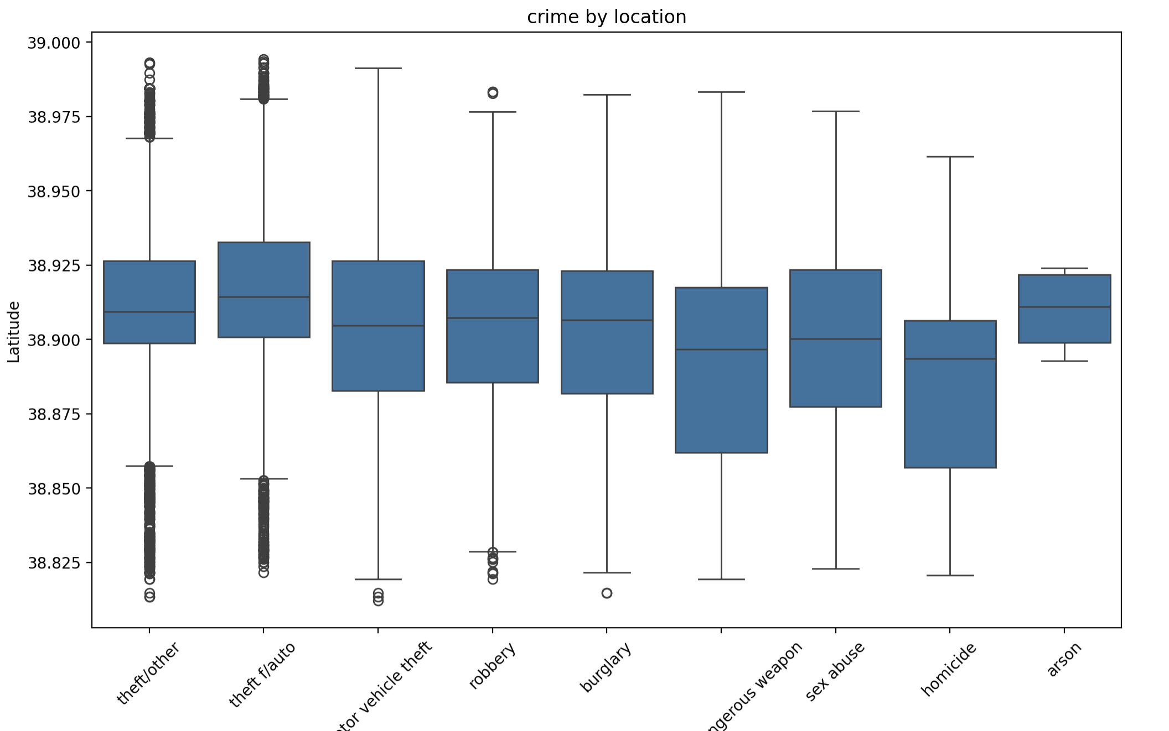
Additional Analysis: Box-Plot Does latitude (geographic location) vary by the type of offense committed?
What: Spatial dispersion of geographic locations and where crimes and their type occur.
Why: To analyze the role in geographic locations and crime types and to look for outliers in types of crimes committed.
Insight: The box plot shows the median value as 38.89-38.91, meaning crimes occur in the same geographic location: Washington, D.C.
Interquartile ranges: similar to one another
The only crimes outside of the Washington, D.C area within our data are theft, motor vehicle theft, robbery, and an exceedingly small part of burglary.

Slide 13

Key Findings
Research questioned answered: Crime occurrences do vary by time.
Crime frequency most prevalent during the evening (3-9 p.m.)
The geographical location of crime occurrences do not play a significant role on crime.
Not a linear relationship between variables (based on categories.)
Neighborhood plays a significant impact in the frequency of crimes.
Differing crimes occur within the Washington, D.C area; however, slight differences from the mean as well as outliers exist suggesting crimes occurring outside this area.

Slide 14

Limitations
Does not examine other categorical factors such as social status within neighborhoods, economic status, etc.
Laws, police enforcement, violations are not considered.
Data set strictly focuses on crimes that were reported within the Washington D.C area.

Slide 15

What Now? Solutions
Expanding surveillance and police presence within certain areas in Washington D.C (Dupont Circle, National Mall, China-Town, etc.)
Increasing more law enforcement/authorities within hours that have high crime frequency.
Civic engagement programs + community service initiatives for neighborhood clusters with high crimes.
Data driven intiatives: Using existing data to assess the likelihood of a crime occurring.

Slide 16
Conclusion
Hour of the day plays a significant factor in crime frequency.
There should be high focus on times where crime frequency is high.
Implementing more awareness/focus on neighborhoods with higher prevalence of crime.
Future investigations must focus on how to decrease/prevent future offenses from occuring by taking data-driven action.

